Slide 1
Local First Workshop
Building Wealth & Impact in Your Small Business
Grand Rapids, June 6, 2023
Roy Messing
Michigan Center for Employee Ownership

Slide 2
Michigan Center for Employee Ownership
Nonprofit outreach center founded in 2022.
Provides educational materials and access to resources for business owners & their advisors to better understand the various options.
Our mission is to expand employee ownership in the state.
We work with a variety of governmental agencies, nonprofits, and for-profit businesses to promote the idea that retiring business owners should explore transferring their business to their employees

Slide 3

The Silver Tsunami is Coming Here
Tsunami by Hokusai, 19th century
Notes:
We all know about the silver tsunami – potentially trillions of dollars in wealth to transact in next decade

Slide 4
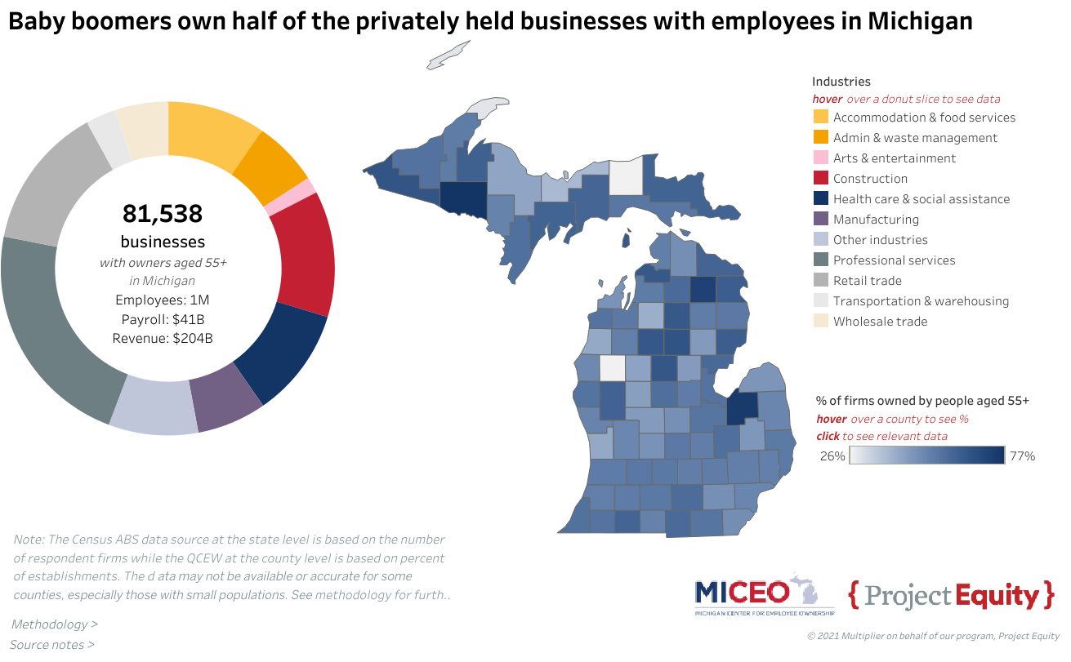

Slide 5
What do we know about these owners & their companies?
Less than 20% of these businesses transfer to the 2nd generation, & under 10% to the third generation.
75% of owners don’t have an exit plan.
Approximately 80% of these owners’ personal wealth is in closely-held businesses.
Outside buyers buy their own self-interest; the business will likely experience significant changes.
The majority of previous business owners are dissatisfied with the exit from their business.

Slide 6
How to move forward?
People generally own businesses to accomplish financial and other personal goals. How will you accomplish these goals?
Given what was stated about the businesses on the previous slide, what is the best way for business owners to move forward?
Option 1. – Do Nothing.
Option 2. – Take Action!
Assess
Plan
Execute

Slide 7
1. Assessment
Regardless of where a business owner is in the ownership cycle (just started, growing the business, or nearing retirement), they should determine their goals for owning the business:
The basic economics of their business.
The desired lifestyle (now and later).
The funding necessary to accomplish those goals
The current value of the business.
The financial gap between the current and desired value.

Slide 8
What are your financial resources to accomplish these goals?
As a business owner, you have assets/resources that you hold personally and assets/resources that are held within the company.
Personal Items:
Cash, investments, vehicles, retirement accounts, real estate, and collectibles.
Business:
The value of the business

Slide 9
Mr. & Mrs. John Q. Public
Major Goals:
Retire in five years
Maintain current Grand Rapids residence
Maintain current living standard
Spend one month a year down south
Take one major trip a year

Slide 10
Mr. & Mrs. John Q. Public
Total Cost:
They meet with their financial planner, and it is determined that they need $2,000,000 of financial resources to accomplish this goal (this includes future social security and retirement payments).
They currently project personal resources of $1,000,000 and had a third party appraise the company at $500,000. With the $1.5 million of resources, the Publics have a wealth gap of $500,000.
How do the Publics address this wealth gap?

Slide 11
List your major goals and desires
What are your goals big and small?
Putting my kids through college
Buy my first home
Paying off my home loan and retiring comfortably
Acquiring a lake house or “winter property”
Buying a yacht and sailing around the world
What will it cost you to meet these goals?

Slide 12
Take stock of your financial stake
Cash & Investments
Retirement accounts
Vehicles & Equipment
Real Property
Businesses
Other
What is the difference or Financial GAP?

Slide 13
Plan Development
The owner needs to review the operation to determine how to increase the value of the business to help meet their individual financial and other goals.
Create a plan that increased the value of the company
Determine if this can be accomplished in the desired timeframe
If not, they will have to either extend their desired timeframe, or reduce their expectations.

Slide 14
Plan Goals
Smart Goals
Specific
Measurable
Achievable
Relevant
Time-Bound

Slide 15
What Drives Business Value
Positive Trends – Sales, Net Income, Working Capital
Customer Diversification & Satisfaction
Qualified Management Team (vs. owner controlled)
Clean Financials
Recurring Revenue
Size of Company

Slide 16
What is under your control?
Positive Trends – Sales, Net Income, Working Capital
Customer Diversification & Satisfaction ????
Qualified Management Team (vs. owner controlled)
Clean Financials – Compiled, Reviewed, Audit
Recurring Revenue ???
Size of Company ???

Slide 17
Focus on Retaining & Developing Staff
Identifying your staffing needs to get to the next level.
Assessing your current staff.
Develop a plan to get the Right People in the Right Seats.
Attract and retain employees:
  Profit sharing
  Equity stake (actual or synthetic)
Long-term transition to employee ownership?

Slide 18
Roles & Responsibilities
What are the five most important roles in your business?
How will these be covered when you retire/leave the business?
Assess your successors/management team’s abilities/skills.
Develop plans to match abilities/skills with needs.

Slide 19
Plan Execution
Select priorities to address (bite size)
Identify key resources
Create a workable framework (90-day goals)
Assign tasks
Establish regular communication
Track your progress
Evaluate performance
Adjust as necessary & repeat

Slide 20
Why Consider an Exit to Employee Ownership
Provides potential tax benefits to owner(s) and employees.
Employees could be partial or full owners of business.
Can provide orderly exit of owner(s).
Create/maintain Legacy in community.
Reward employees for years of service.
Other exit options may be limited or undesirable.

Slide 21
Why Employee Ownership vs. An Outside Sale
Does the owner have a strong desire to have the business remain intact following their exit?
Is there a strong succeeding management team already in place? If not, one can easily be assembled.
How likely is an outside sale going to satisfy all the needs of the business owner?
How much time and effort is “wasted” on businesses that aren’t destined for a successful outside sale.

Slide 22
Employee Ownership candidate characteristics
Business operation with a proven business model.
Operates in industry with expected longevity.
Predicable positive earnings.
Sound management team (post owner exit).
Ability to take on additional debt.
Workforce stability.
Workforce engagement at multiple levels.

Slide 23
Three main employee ownership structures
Employee Stock Ownership Plan (ESOP)
Employee or Worker Owned Cooperatives
Employee Ownership Trusts (EOTs)

Slide 24
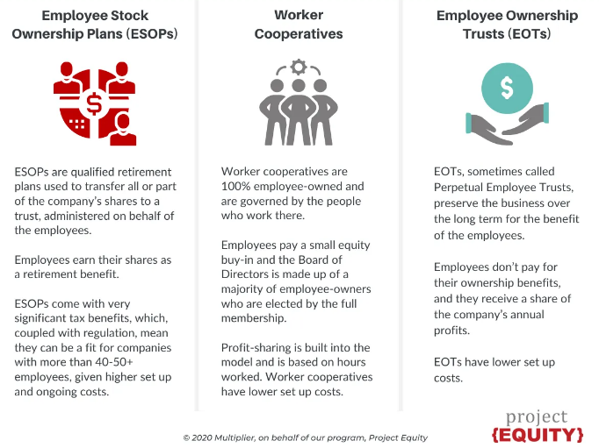
















Slide 25
Structure Highlights
ESOPs
Includes all qualified employees
Comply with IRS rules and ERISA (DOL)
40 or more employees
(sometimes can be less)
Highly complex ERISA rules – heavy penalties
$100K+ to set up
$25k+ annually
About 7,000 in US
Cooperatives
Includes employees that “buy in”
Comply with IRS rules
& Coop principles
20 or less employees (can be more)
Flexibility in creating coop structure
$25k+ to set up
$5k+ annually
Under 1,000 in US
EOT
Includes all qualified employees per rules
Comply with IRS rules and state trust laws
20 or more employees
All employees get equal share of annual profits
Flexibility in structuring
$50k + to set up
$10k + annually
Under 50 in US

Slide 26
Worker Cooperatives
Worker cooperatives are like other co-ops: they are owned directly by employee members who pay a membership fee and who receive patronage allocations.
Patronage dividends are allocated on the basis of their labor input (& other predetermined items) and are taxable to the member.
The co-op is the operating entity and members have a direct say in their operation.
Because worker co-ops are less expensive to set up and maintain (as compared to ESOPs), they are highly cost-effective in ownership succession in small businesses.

Slide 27
Worker Cooperatives
Characteristics
Relatively inexpensive to establish and maintain
Can borrow money from banks
Ultimately must be 100% employee owned
Selling owner maintains some control during transfer
Member vote on 1 member – 1 vote

Slide 28
EOTs
Trust owns the shares of the company.
Trustees direct overall company direction.
Employees don’t own company, rather they benefit from the company’s ongoing operations & profitability.
Doesn’t have to comply with ERISA rules.
Can have additional compensation plans for management or select groups.
EOT’s can’t provide potential tax benefits like ESOPs.

Slide 29
Resources Available to Support Employee Ownership Conversions
Legal Support
  Some experienced lawyers in Michigan & neighboring states
  Outreach and education to grow the base
Advisory Services
  State Small Business Credit Initiative Technical Assistance
  Educating advisors on these options
Financing Support
  Banks
  Community Development Financial Institutions
General Business Education
  Outreach to build awareness of the employee ownership options

Slide 30
Contact Information
Roy J. Messing
Executive Director
Michigan Center for Employee Ownership
Website: www.miceo.org
LinkedIn: Michigan Center for Employee Ownership
Email: rmessing@miceo.org
Phone: 440.567.1060

